Slide 1

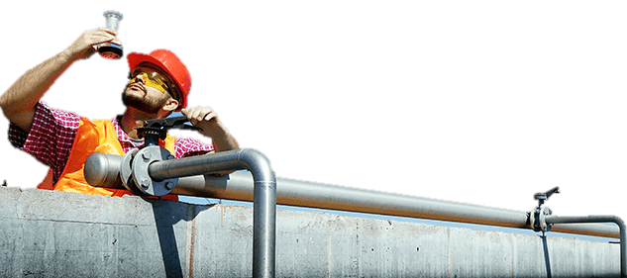
GAMMA TECH FZE

Slide 2

Greetings from Gamma Tech FZE Team!
We are the reliable partner in the Central Asian region, specializing in Oil, Gas and Water Treatment industry. Please let us tell you more about us:

Slide 3
Company overview

Slide 4
We make your gears spin

Slide 5
Vision
Our vision is to become one of the leading provider of technical services and chemical products, equipment and materials for Oil & Gas and Water Treatment Industries of Central Asia

Slide 6
Brief overview
Supply of chemicals and wide range of equipment for Oil and Gas Clients in Central Asia
Over 150 professionals working for Gamma Tech family
Supply of chemicals and equipment with provision of technical services and inspections for our Oil & Gas Clients
Successfully completed over 60 projects involving supplies of materials and technical support for our Turkmenistan Clients
Collaborating with industry-best manufacturers to provide our clients with new and more effective solutions, and to increase our partners-suppliers’ market share in the region.

Slide 7













Our Clients
PETRONAS

Slide 8

















Our Partners

Slide 9
Presence of Gamma Tech FZE in Middle East
JAFZA
DMCC
Gamma Tech FZE established in Dubai, UAE in 2009 and currently has two offices located in Dubai, United Arab Emirates:
  The administrative (registered) office is situated at Jebel Ali Free-Trade Zone (JAFZA);
  The operational office is located in one of Dubai’s main business centers (DMCC) in Jumeirah Lakes Towers (JLT).

Slide 10
Main office
  The operational office is located at JLT, proceeds the following operations with suppliers and clients:
    material procurement and cargo management;
    Bidding for Tenders;
    industrial projects design, including development of the accompanying project documentation;
    selection of required equipment, technical consultancy services.

Slide 11

LOCAL PRESENSE IN TURKMENISTAN

Slide 12
We work in Turkmenistan since 2009 and this is our main business region.
Our team in Turkmenistan consists of highly qualified engineers and technologists who have over 20 years of experience in Oil and Gas, on average, and have worked with our Clients previously. As of today, we employ over 130 people in Turkmenistan.
We have 3 offices strategically located in the main cities (Ashgabat, Turkmenbashy, Balkanabat) to cover the territory and maintain close relationships with our Clients in the most efficient way.

Slide 13

Gamma Tech FZE, having its main market in Turkmenistan, closely cooperates with local Turkmen sister companies, who represents us in this country.
We have:
Warehouses with a total area of over 7000 m2 which are suitable for storage of DG chemicals intended for our customers. Thus, we can deliver chemical products upon our client’s request within 1- 3 day at their sites located all over Turkmenistan.
All necessary licenses for the import of chemicals, including License of import of hazardous chemicals which require special permission of President of Turkmenistan
Equipment, construction materials and machinery.
Vehicle fleet
Mechanical, electrical and pneumatic instruments
Our partner companies are also engaged in customs clearance, local logistics, providing warehousing of goods and administrative support.

Slide 14
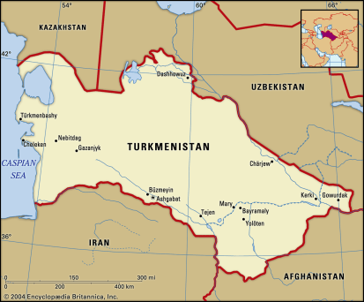
Three offices representing interests of our company in this country:
1. Office located in Ashgabat, is a local head office and works with such clients as SC "Turkmengas" SC "Turkmennebit", Balkan Cement Factory, ENI Turkmenistan, CNPC, Schlumberger, Mitro International Ltd., PETRONAS Carigali (Turkmenistan) Sdn Bhd, Petrofac International Ltd, etc.;
2. Turkmenbashy office mainly works with Turkmenbashy Oil Processing Complex and Kiyanly Polymer Plant belonging to Turkmengas State Concern;
3. Balkanabat office is looking after two main areas: implementation and control of the materials logistics, customs clearance, warehousing and support of our customers water treatment facilities
Find more maps at slidescarnival.com/extra-free-resources-icons-and-maps

Slide 15
Our main Customers in Turkmenistan are Governmental or Semi-Governmental companies:
Governmental
Semi-Governmental
Turkmenbashy Oil Processing Complex (including Seidy Refinery)
Turkmengas State Concern (includes all their Plants and Bases)
Turkmennebit State Concern
Turkmenhimiya State Concern
Balkanvelayatagyzsuv mudirligi (Balkan region’s water supply organization)
Balkan Cement factory
Petronas Carigali (Turkmenistan) Sdn Bhd
ENI Turkmenistan Ltd.
Dragon Oil
CNPC
Kawasaki Heavy Industries
Burren RPL
SCHLUMBERGER LOGELCO INC
Petrofac International Ltd

Slide 16
Distribution and due diligence
Gamma Tech FZE is appointed Distributor or Representative Agent in Turkmenistan for such companies as:
- UOP, A Honeywell Company (USA) – since 2013;
- Hydranautics A Nitto Denko Company (USA) – since 2012;
- ChampionX (USA) – since 2014;
- Nalco Water (USA) – since 2012;
- BASF SE (Germany) – since 2012;
- INEOS (United Kingdom) – since 2018.
In order to assure that we fulfill our commitments and perform our activities in accordance with legal requirements and mitigate any risks in medium-term and long-term periods, Gamma Tech FZE is ready to provide all necessary financial reports that are prepared and certified by thrid party auditing companies, as well as technical reports covering the progress of our mutual projects.

Slide 17
Our Facilities in Turkmenistan

Slide 18
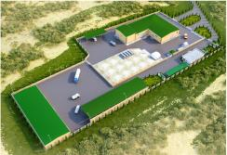
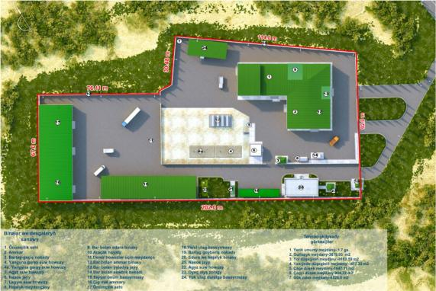
BASE № 1: Chemical Blending and Production Plant
with a Warehouse in Turkmenbashy

Slide 19
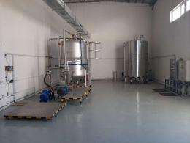
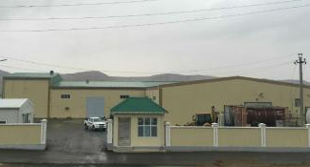
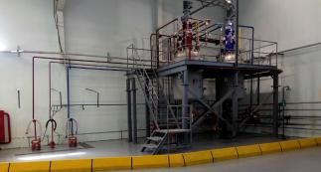
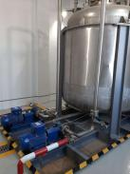
Plant for production of aqueous solution
Main Entrance
Pour Point Depressant (PPD)
Plant for mixing oil and gas chemicals

Slide 20
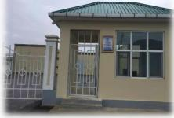
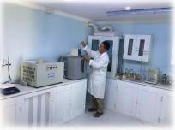
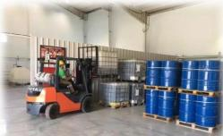

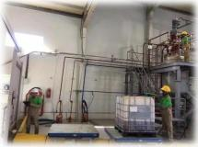
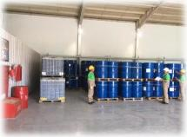
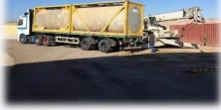
Main gate
Laboratory
Warehouse
Loading Bay
Packing

Slide 21
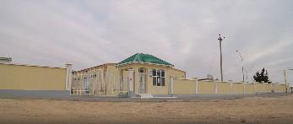
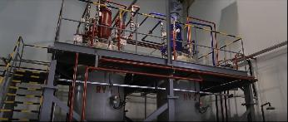
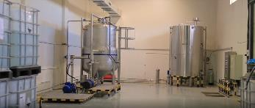
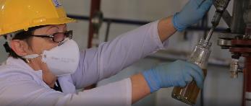
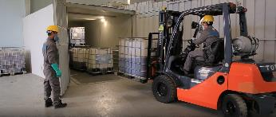
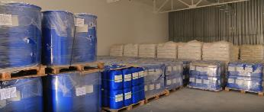

Slide 22
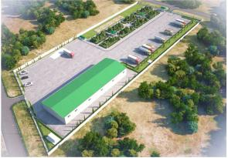
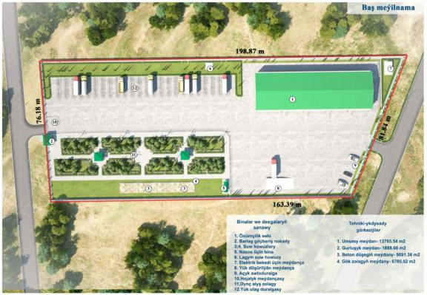
BASE № 2: Cartridge Filter Plant with a Warehouse in Balkanabat

Slide 23
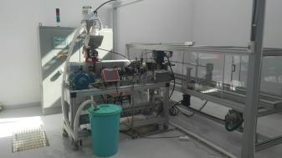
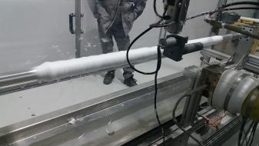

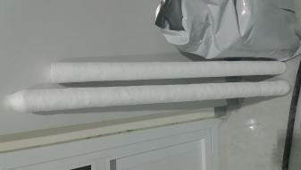
General view of the installation
Working process - spilling polypropylene fiber onto the plastic filter core
Raw material - Polypropylene
Finished product - Filter for water purification with a filtration rate of 1 to 5 microns

Slide 24
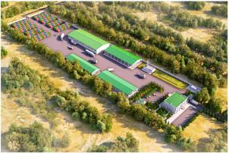
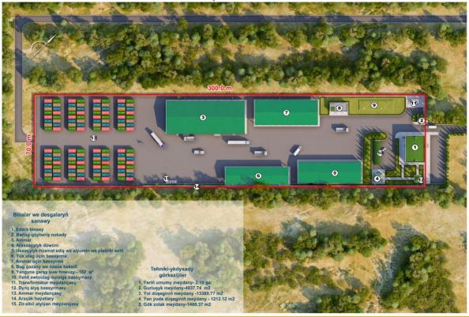
Base № 3: Warehouse for DG goods in Balkanabat and Nitrogen Plant under construction

Slide 25
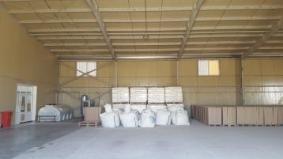
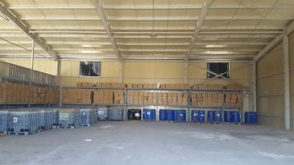
Warehouse on Base #3

Slide 26
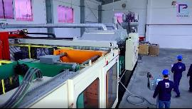
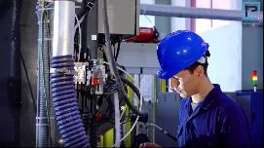
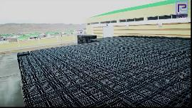


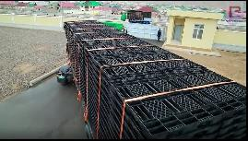
Base № 4: Pallet Plant with a Warehouse

Slide 27
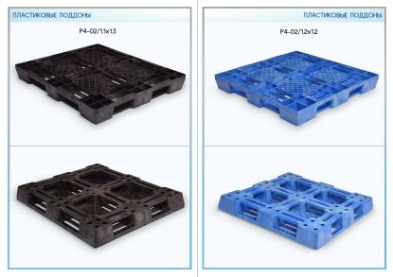
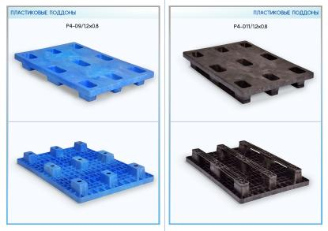
Pallet Samples

Slide 28
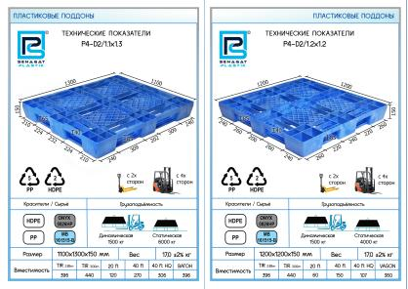
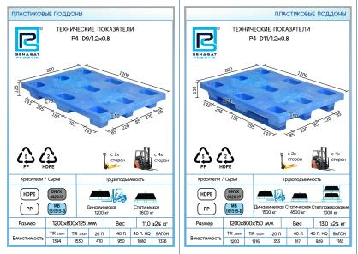
Pallet Specification

Slide 29
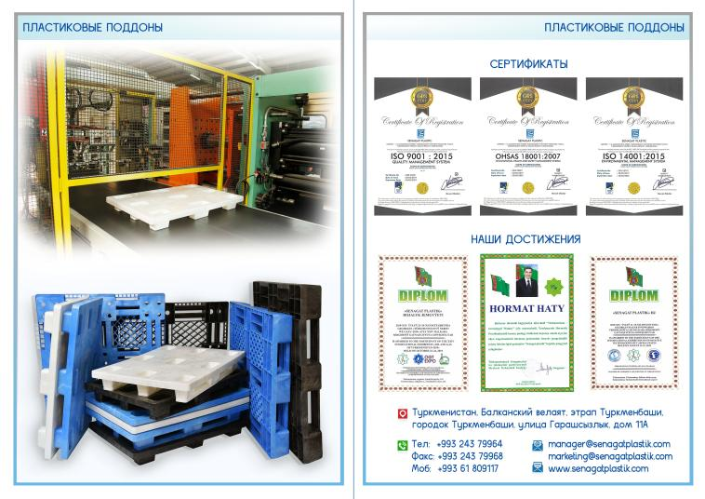

Slide 30

Thanks!
Any questions?
You can find us at:
office.dxb@gammatm.com
+971 4 453 9409
+971 4 887 0471
Operational office: Office 41-A, Almas Tower, JLT, Dubai, UAE
Registered office: Office LB14305, Jebel Ali Free Zone, Dubai, UAE P.O. Box 263022
www.gammatm.com
+971 4 453 9410

